Slide 1

Marimagang.com as Media for
Seeking Internship Place & Student Monitoring
Made By
Glasses Team
Indonesia Computer University
Faculty of Engineering and Computer Science
Informatics Engineering

Slide 2
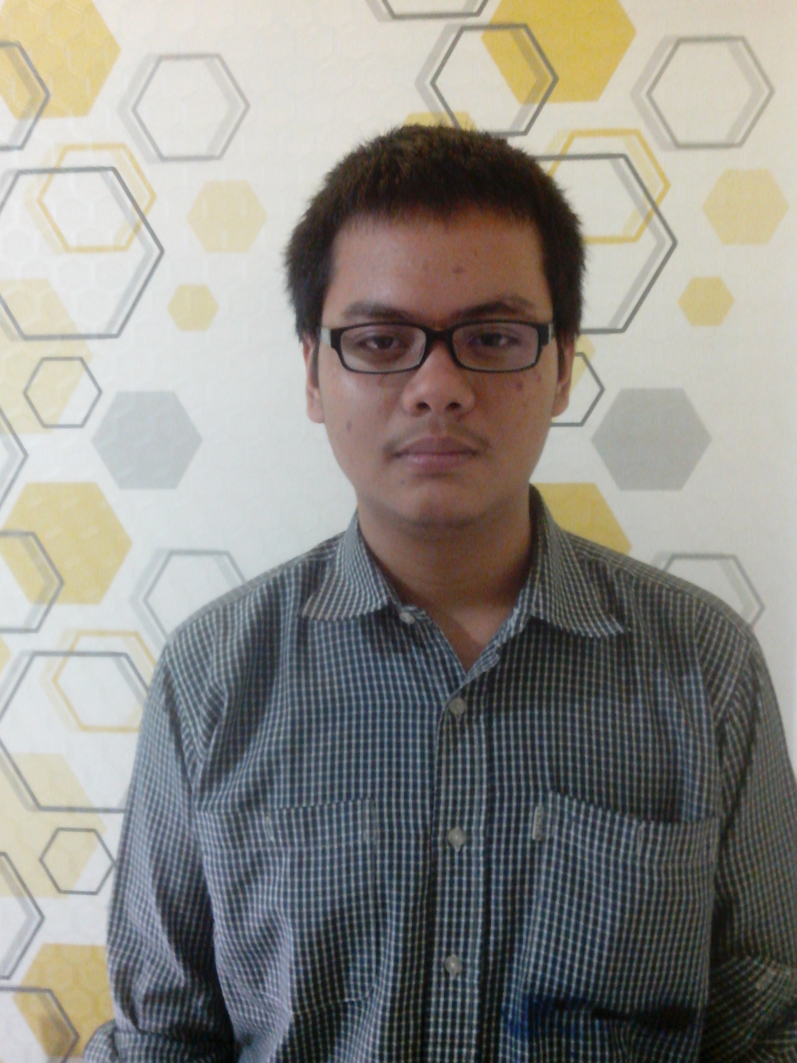




Glasses Team
Ismail Zakky
Andrew Toy
Ahmad Paudji H.S
Handoyo
Wupi Ocktavia

Slide 3


4.8 Billion
Indonesia has a lot of state and private companies
131 Thousand
Every year many students need to get internship

Slide 4

Anyone could help me to find
internship place ?

Slide 5

Is there any tools which can help me for monitoring & controlling my student ?

Slide 6




Employer
Apps User
Student
Administrator
Visitor

Slide 7
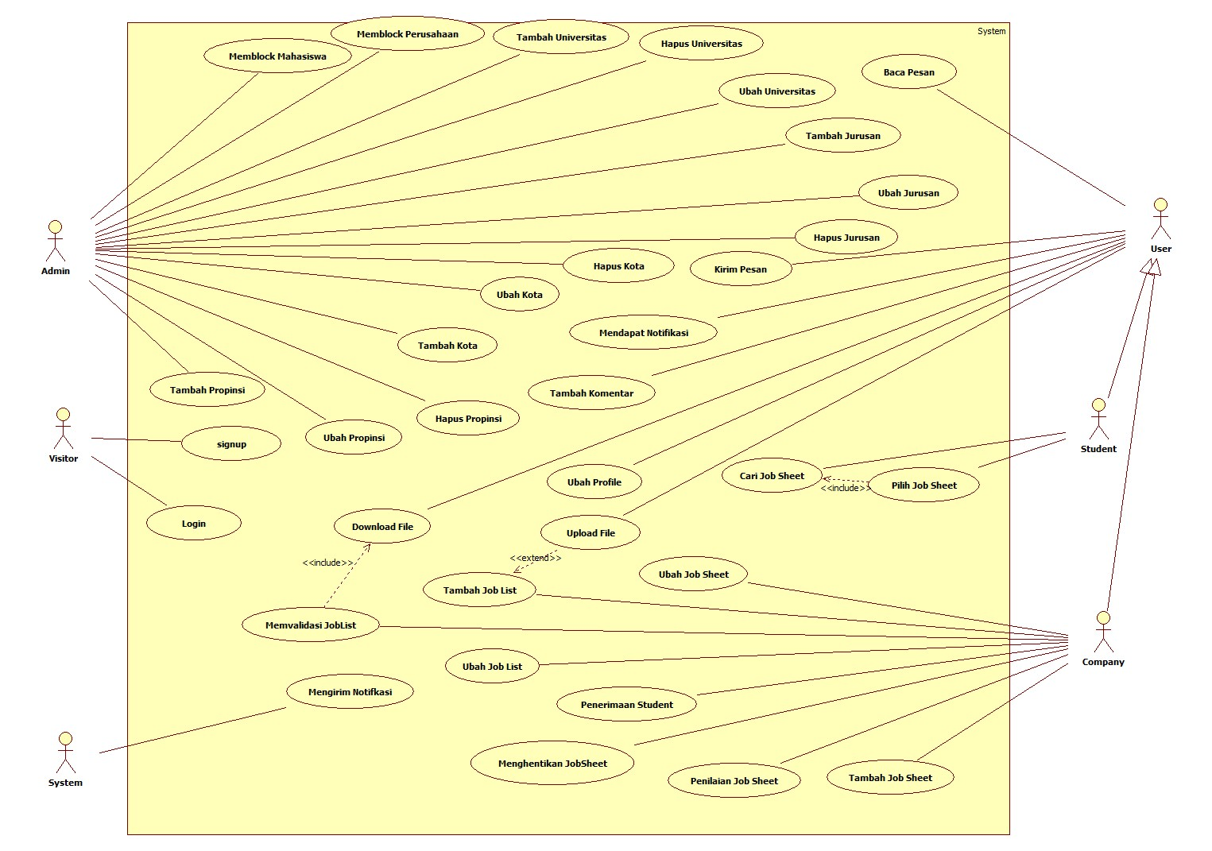


Process Model
(Use Case)

Slide 8
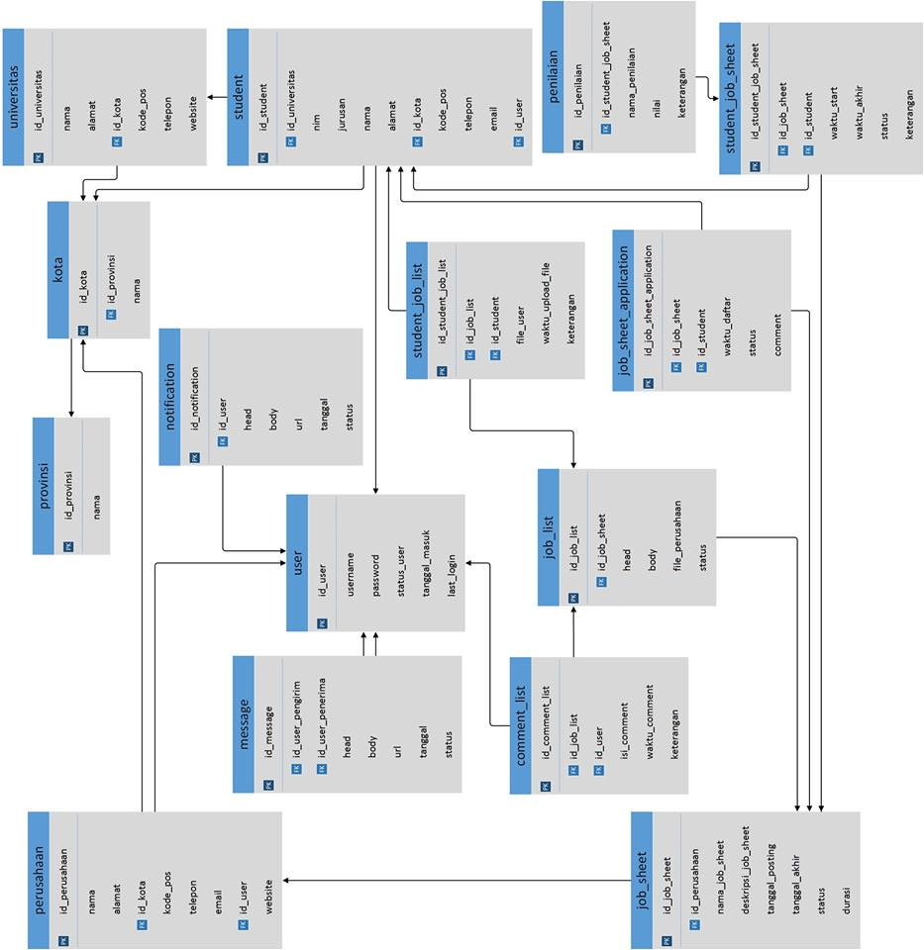
Data Model
(Relation Scheme)

Slide 9

Apps DEMO
www.marimagang.com

Slide 10

Thanks For Your Attention…
Success start from 99% of effort and 1% of luck
--Albert Einstein--

